Slide 1
ClickHouse LangGraph Agent Workshop
2025
User guide, slide examples, and icon bank

Slide 2

Prerequisites
Clone https://github.com/alexkorep/clickhouse-langgraph-agent-workshop
Run in GitHub Codespace
pip install -r requirements.txt

Slide 3
What We'll Build Today
Build an AI agent for ClickHouse database queries
Understand natural language questions
Agent writes and executes SQL queries
Returns results in a human-friendly format

Slide 4
Architecture Overview
User Question (Natural Language)
↓
LLM (OpenAI)
↓
Agent (ReAct)
↓
Tool: ClickHouse Query
↓
Results + Explanation

Slide 5
Tech Stack
LangChain/LangGraph - Agent framework
OpenAI GPT - Language model
ClickHouse - Database
Python - Everything ties together

Slide 6
Prerequisites
Clone https://github.com/alexkorep/clickhouse-langgraph-agent-workshop
Run in GitHub Codespace
pip install -r requirements.txt

Slide 7
Environment Setup
Create `.env` file:
OPENAI_API_KEY=sk-...
OPENAI_MODEL=gpt-4o-mini
CLICKHOUSE_HOST=localhost
CLICKHOUSE_PORT=8123
CLICKHOUSE_USER=default
CLICKHOUSE_PASSWORD=
See .env.example

Slide 8
Step 0
Basic CLI Structure

Slide 9
Step 0: Test It
```bash
python agent.py "Hello world"
```
Output:
```
Hello world
```

Slide 10
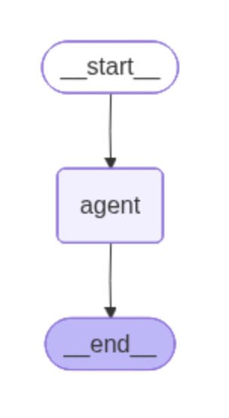
Step 1: A simple ReAct agent
llm = ChatOpenAI(
model=DEFAULT_MODEL,
api_key=OPENAI_API_KEY,
)
# Create the agent executor
tools = []
agent_executor = create_react_agent(
llm,
tools,
)

Slide 11
Step 1: Test It
```bash
python agent.py "What is 2+2?"
```
Output:
```
2 + 2 equals 4.
```

Slide 12
What is ReAct?
Reasoning + Acting
The agent follows this loop:
1. Think - Reason about what to do
2. Act - Use a tool or give answer
3. Observe - See tool results
4. Repeat - Until question is answered
LangGraph's `create_react_agent` handles all this for us!

Slide 13
Step 2
Add a Simple Tool

Slide 14
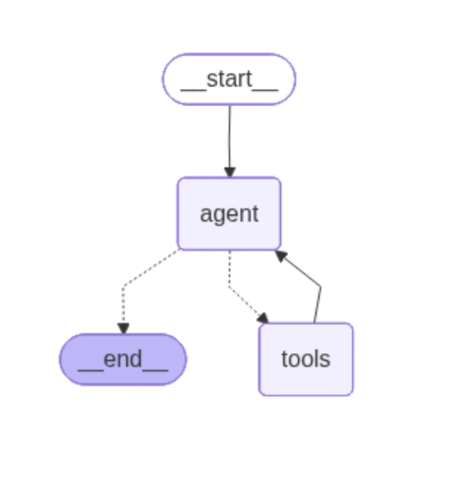
Agent graph structure
@tool
def my_encoder(text: str) -> str:
"""A simple text encoder tool."""
print(f'Tool called with input: {text}')
return text + text.upper()
tools = [my_encoder]
agent_executor = create_react_agent(
llm,
tools,
)

Slide 15
Step 2: Understanding Tools
Tools = Functions the agent can call
To create a tool:
Write a Python function
Add `@tool` decorator
Write a good docstring (agent reads this!)
Add to tools list

Slide 16
Step 2: Test the tool calls
$ python agent_step2.py "Please encode the word hello"
Tool called with input: hello
Tool returning: helloHELLO
Encoded result: helloHELLO
Would you like a different encoding (e.g., base64, ROT13, hex)?
Agent successfully:
1. Understood it needed to use a tool
2. Called the tool with correct input
3. Interpreted the result

Slide 17
Step 2: Test the agent reasoning
$ python agent_step2.py "Please encode the word hello and then encode the result again and do it as long as the result is shorter than 15 characters"
Tool called with input: hello
Tool returning: helloHELLO
Tool called with input: helloHELLO
Tool returning: helloHELLOHELLOHELLO
Done.
- Start: "hello" (5 chars)
- 1st encoding: "helloHELLO" (10 chars)
- 2nd encoding: "helloHELLOHELLOHELLO" (20 chars)
Stopped after the 2nd encoding because the result is no longer shorter than 15 characters. Final result: "helloHELLOHELLOHELLO" (20 chars).

Slide 18
Step 3. The Real Tool: ClickHouse
@tool
def query_clickhouse(query: str) -> str:
""" Execute a SQL query against ClickHouse database.
Use this tool when you need to retrieve data from the database.
Args: query: A valid ClickHouse SQL query string
Returns: Query results as a formatted string """
client = clickhouse_connect.get_client(...)
result = client.query(query)
data = [dict(zip(result.column_names, row)) for row in result.result_rows]
return json.dumps(data, indent=2, default=str)

Slide 19
Step 3: Test
python agent.py "Show me the first 5 rows from system.tables"
The agent will:
Understand the request
Write SQL: `SELECT * FROM system.tables LIMIT 5`
Execute the query
4.Return and explain results

Slide 20
Demo: Example Questions
What tables exist in the database?
What's the total size of all tables?
Analyze table X

Slide 21
Step 4. Better Visibility with Streaming
event_iterator = agent_executor.stream({"messages": messages})
for event in event_iterator:
for _node, value in event.items():
msg_list = value.get("messages", [])
last = msg_list[-1]
if isinstance(last, AIMessage):
reasoning_text = last.content
tool_calls = getattr(last, "tool_calls", None)
if reasoning_text:
print(f"\n[Reasoning] {reasoning_text}")
if tool_calls:
# Print each tool call input
...
else:
final_answer = reasoning_text
elif isinstance(last, ToolMessage):
tool_name = getattr(last, "name", "tool")
print(f"[Tool Result - {tool_name}] {last.content}")
if final_answer:
print(final_answer)

Slide 22
Step 4: Why Streaming?
With streaming, you see:
Agent's reasoning process
Tool calls in real-time
Tool results
Final answer
Messages appearing character-by-character (not implemented)

Slide 23
What's Next?
Memory & Conversation History
Human-in-the-Loop
Multiple Tools
Custom Graphs
Other LLMs
Production Considerations

Slide 24
Learning Resources
Documentation:
LangChain: https://python.langchain.com/docs/introduction/
LangGraph: https://docs.langchain.com/oss/python/langgraph/overview
OpenAI: https://platform.openai.com/docs/overview

Slide 25
Questions?

